Slide 1

Sudoku Solver
Harshita Rajoria
Reg.No.:12224044
Roll No.:48
Section: 9SK02

Slide 2
Acknowledgement
I would like to express my sincere gratitude to Rahul Sir, our trainer, for providing us with the opportunity to participate in the Summer Term Training and Project. His guidance, support, and expertise have been invaluable throughout our journey.
I would also like to extend my appreciation to the university for organizing this training program and for giving us the chance to work on a real-world project like the Sudoku Solver. This experience has been immensely beneficial in enhancing our skills and knowledge in computer science and web development.
The training sessions conducted by Rahul Sir have been informative, engaging, and have provided us with a solid foundation in various technologies and best practices. His patience, dedication, and willingness to share his knowledge have been truly commendable.
Through this project, we have gained hands-on experience in building a web application from scratch, utilizing modern tools and frameworks. The step-by-step visualization of the Sudoku Solver problem and the ability to control the speed of the algorithm have been particularly interesting aspects of the project.
We are grateful for the opportunity to work on this project and to learn from Rahul and the university. This experience has been a valuable addition to our academic and professional growth, and we look forward to applying the skills and knowledge gained here in our future endeavors.

Slide 3
Principle behind a Sudoku solver:
The principle behind a Sudoku solver is to fill in the grid in such a way that each row, each column, and each of the 3x3 subgrids (also called boxes or regions) contains all of the digits from 1 to 9 exactly once. Here are the main techniques used in solving Sudoku puzzles:
Backtracking Algorithm:
This is a form of depth-first search where the solver tries to place a number in an empty cell, then recursively attempts to fill the next cell.
If a conflict is found (i.e., a number repeats in the same row, column, or subgrid), the solver backtracks to the previous step and tries the next possible number.
This process continues until the puzzle is solved or no solution exists.

Slide 4
Backtracking
Backtracking is a general algorithmic technique for solving problems incrementally, by trying partial solutions and then abandoning them if they are not suitable (i.e., they do not lead to a valid complete solution). It is particularly useful for problems involving combinatorial search spaces, such as puzzle solving, constraint satisfaction, and optimization problems.
Here’s how backtracking works:
Choose:
Make a choice about the next step in the solution. This often involves selecting a candidate from a set of possibilities.
Explore:
Recursively explore the consequences of that choice by making further choices. This often involves calling the same algorithm with a smaller subproblems or more constrained state.
Backtrack:
If the current choice leads to a solution, return success.
If the current choice does not lead to a solution, undo the choice (backtrack) and try the next possible choice.
This process continues until all possibilities are explored, or a solution is found.

Slide 5
Solving Sudoku with Backtracking
Choose:
Start with the first empty cell and choose a number from 1 to 9.
Explore:
Place the chosen number in the cell and move to the next empty cell.
Check if placing the number violates any Sudoku rules (each number must be unique
in its row, column, and subgrid).
If placing the number is valid, recursively attempt to fill the next cell using the same process.
Backtrack:
If placing the number leads to an invalid state or no solution, undo the placement
(remove the number) and try the next possible number in the current cell.
If all numbers have been tried and none work, backtrack to the previous cell and
try the next number there.

Slide 6
Code for Sudoku Solver
import javax.swing.*;
import java.awt.*;
import java.awt.event.ActionEvent;
import java.awt.event.ActionListener;
import java.util.Random;
public class SudokuSolverWithVisualization extends JFrame {
private static final int SIZE = 9;
private JTextField[][] cells;
private int delay = 100; // Delay for visualization
private Random random = new Random();
public SudokuSolverWithVisualization() {
setTitle("Sudoku Solver with Visualization");
setSize(600, 600);
setDefaultCloseOperation(JFrame.EXIT_ON_CLOSE);
setLayout(new BorderLayout());
JPanel boardPanel = new JPanel(new GridLayout(SIZE, SIZE));
cells = new JTextField[SIZE][SIZE];
for (int i = 0; i < SIZE; i++) {
for (int j = 0; j < SIZE; j++) {
cells[i][j] = new JTextField();
cells[i][j].setHorizontalAlignment(JTextField.CENTER);
cells[i][j].setFont(new Font("Arial", Font.BOLD, 20));
cells[i][j].setBorder(BorderFactory.createLineBorder(Color.BLACK));
boardPanel.add(cells[i][j]);
}
}

Slide 7
JButton solveButton = new JButton("Solve");
solveButton.addActionListener(new ActionListener() {
@Override
public void actionPerformed(ActionEvent e) {
int[][] board = new int[SIZE][SIZE];
for (int i = 0; i < SIZE; i++) {
for (int j = 0; j < SIZE; j++) {
String text = cells[i][j].getText();
if (!text.isEmpty()) {
board[i][j] = Integer.parseInt(text);
} else {
board[i][j] = 0;
}
}
}
new Thread(() -> {
if (solveSudoku(board, 0, 0)) {
updateBoard(board);
} else {
JOptionPane.showMessageDialog(SudokuSolverWithVisualization.this, "No solution exists", "Error", JOptionPane.ERROR_MESSAGE);
}
}).start();
}
});
JButton generateButton = new JButton("Generate");
generateButton.addActionListener(new ActionListener() {
@Override
public void actionPerformed(ActionEvent e) {
generateSudoku();
}
});

Slide 8
JSlider speedSlider = new JSlider(0, 1000, delay);
speedSlider.setMajorTickSpacing(200);
speedSlider.setPaintTicks(true);
speedSlider.setPaintLabels(true);
speedSlider.addChangeListener(e -> delay = speedSlider.getValue());
JPanel controlPanel = new JPanel();
controlPanel.add(new JLabel("Speed:"));
controlPanel.add(speedSlider);
controlPanel.add(solveButton);
controlPanel.add(generateButton);
add(boardPanel, BorderLayout.CENTER);
add(controlPanel, BorderLayout.SOUTH);
}

Slide 9
private boolean solveSudoku(int[][] board, int row, int col) {
if (row == SIZE - 1 && col == SIZE) {
return true;
}
if (col == SIZE) {
row++;
col = 0;
}
if (board[row][col] != 0) {
return solveSudoku(board, row, col + 1);
}
for (int num = 1; num <= SIZE; num++) {
if (isValid(board, row, col, num)) {
board[row][col] = num;
updateCell(row, col, num, Color.GREEN);
sleep(delay);
if (solveSudoku(board, row, col + 1)) {
return true;
}
board[row][col] = 0;
updateCell(row, col, 0, Color.RED);
sleep(delay);
}
}
return false;
}

Slide 10
private boolean isValid(int[][] board, int row, int col, int num) {
for (int x = 0; x < SIZE; x++) {
if (board[row][x] == num || board[x][col] == num) {
return false;
}
}
int sqrt = (int) Math.sqrt(SIZE);
int boxRowStart = row - row % sqrt;
int boxColStart = col - col % sqrt;
for (int r = boxRowStart; r < boxRowStart + sqrt; r++) {
for (int d = boxColStart; d < boxColStart + sqrt; d++) {
if (board[r][d] == num) {
return false;
}
}
}
return true;
}

Slide 11
private void updateBoard(int[][] board) {
SwingUtilities.invokeLater(() -> {
for (int i = 0; i < SIZE; i++) {
for (int j = 0; j < SIZE; j++) {
cells[i][j].setText(board[i][j] != 0 ? String.valueOf(board[i][j]) : "");
cells[i][j].setBackground(Color.WHITE);
}
}
});
}
private void updateCell(int row, int col, int num, Color color) {
SwingUtilities.invokeLater(() -> {
cells[row][col].setText(num != 0 ? String.valueOf(num) : "");
cells[row][col].setBackground(color);
});
}

Slide 12
private void sleep(int delay) {
try {
Thread.sleep(delay);
} catch (InterruptedException e) {
e.printStackTrace();
}
}
private void generateSudoku() {
int[][] board = new int[SIZE][SIZE];
fillDiagonal(board);
solveSudoku(board, 0, 0);
removeDigits(board);
updateBoard(board);
}
private void fillDiagonal(int[][] board) {
int sqrt = (int) Math.sqrt(SIZE);
for (int i = 0; i < SIZE; i += sqrt) {
fillBox(board, i, i);
}
}

Slide 13
private void fillBox(int[][] board, int row, int col) {
int num;
for (int i = 0; i < (int) Math.sqrt(SIZE); i++) {
for (int j = 0; j < (int) Math.sqrt(SIZE); j++) {
do {
num = random.nextInt(SIZE) + 1;
} while (!isSafeInBox(board, row, col, num));
board[row + i][col + j] = num;
}
}
}
private boolean isSafeInBox(int[][] board, int row, int col, int num) {
for (int i = 0; i < (int) Math.sqrt(SIZE); i++) {
for (int j = 0; j < (int) Math.sqrt(SIZE); j++) {
if (board[row + i][col + j] == num) {
return false;
}
}
}
return true;
}

Slide 14
private void removeDigits(int[][] board) {
int count = random.nextInt(20) + 40; // Randomly remove between 40 and 60 digits
while (count != 0) {
int cellId = random.nextInt(SIZE * SIZE);
int row = cellId / SIZE;
int col = cellId % SIZE;
if (board[row][col] != 0) {
board[row][col] = 0;
count--;
}
}
}
public static void main(String[] args) {
SwingUtilities.invokeLater(() -> new SudokuSolverWithVisualization().setVisible(true));
}
}

Slide 15
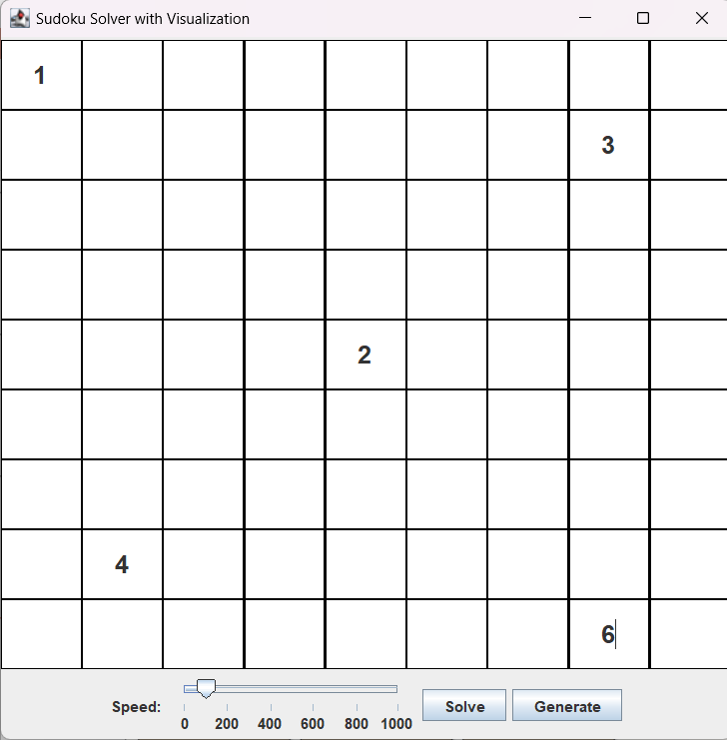
Screenshots manually entering values:-

Slide 16
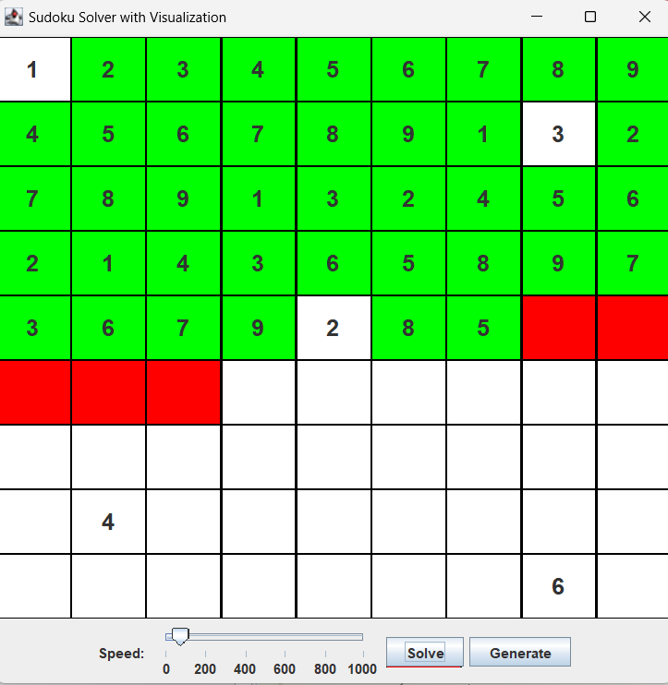
Solving Sudoku

Slide 17
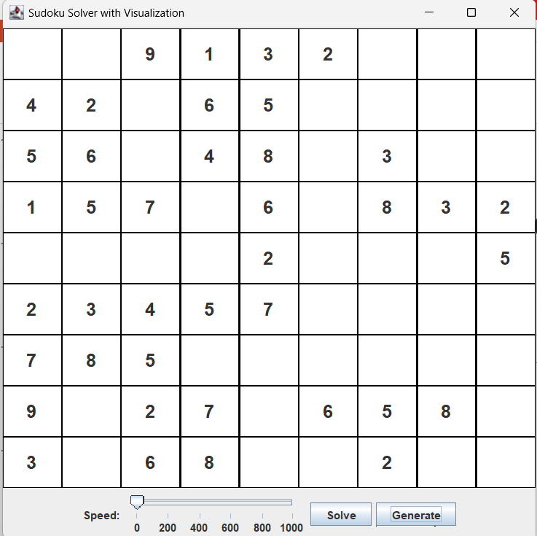
Already generated grid:-

Slide 18
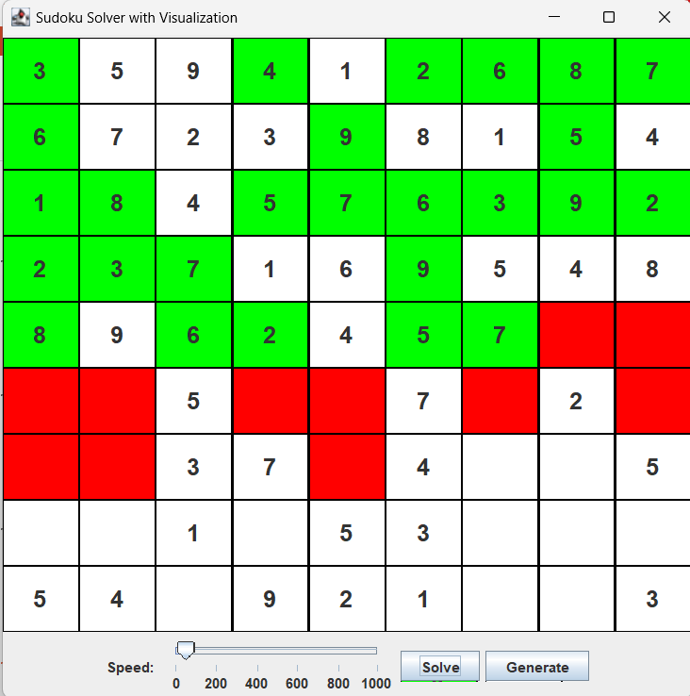
Solving Sudoku:-

Slide 19
Conclusion
In conclusion, the Sudoku Solver Visualizer project has provided us with invaluable experience in web development and algorithm visualization. We have learned to build a responsive and interactive web application from scratch, applying modern tools and frameworks.
We extend our heartfelt gratitude to Rahul Sir for his guidance and to the university for this opportunity. The skills and knowledge gained from this project will significantly contribute to our academic and professional growth.

Slide 20
Thank you for your attention.

